Slide 1

Employment Trends Among Engineering Graduates: Findings from the AMEO 2015 Dataset

Slide 2


About me
Hello! My name is Ajay Kumar Maharana and I am from Chhattisgarh. I completed my Masters in Computer Science from St. Thomas College, Bhilai, Chhattisgarh.
I want to become a data scientist because it combines my passion for problem-solving with the power of data. Data science allows me to extract meaningful insights that can drive impactful decisions across industries. The field offers continuous learning opportunities, from advanced analytics to machine learning, which keeps me engaged and challenged. I’m excited about using data to solve real-world problems and contribute to innovative solutions that can improve processes and drive growth.
https://www.linkedin.com/in/ajay-kumar-maharana/
https://github.com/AjRana09

Slide 3
Objective of Project :
Analyze and predict employment outcomes of engineering graduates based on their cognitive, technical, personality skills and demographic characteristics.
Data Description:
The dataset, released by Aspiring Minds as part of the Aspiring Mind Employment Outcome 2015 (AMEO) study, focuses on employment outcomes for engineering graduates.
It includes dependent variables such as salary, job titles, and job locations, alongside standardized scores for cognitive, technical, and personality skills.
The dataset also contains demographic features and consists of around 40 independent variables (both continuous and categorical) and 4000 records. Each candidate is uniquely identified within the dataset.

Slide 4
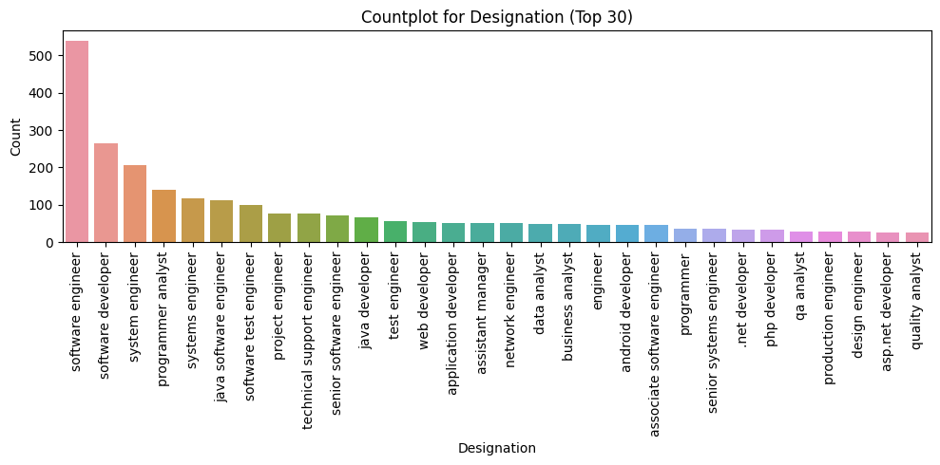
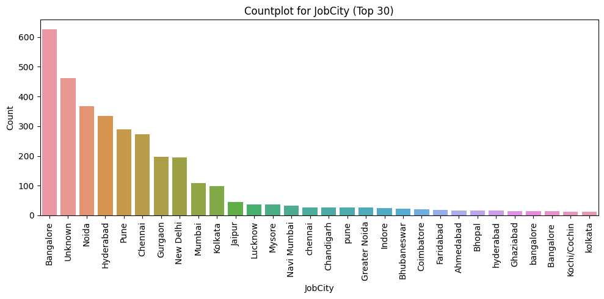
Univariate Categorical Analysis :
Most candidates are working as software engineer, then followed by software developer and system engineer.
Most candidates are working in Bangalore, then followed by Unknown and Noida.

Slide 5
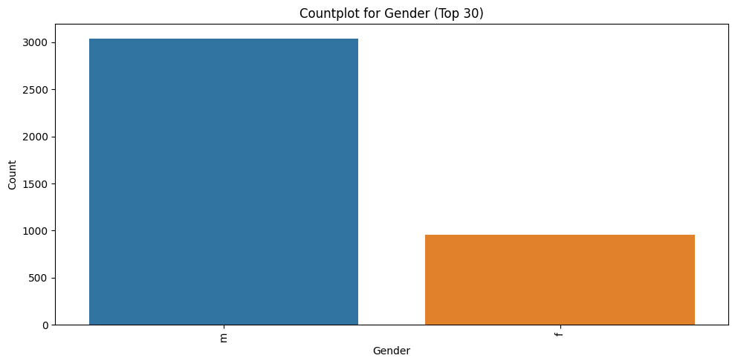
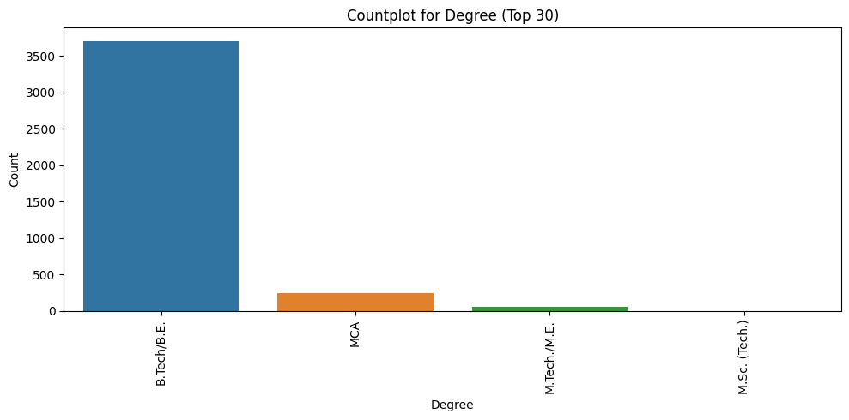
Univariate Categorical Analysis :
Most candidates are males compared to females.
Most candidates completed their Degree in B.Tech./B.E.

Slide 6
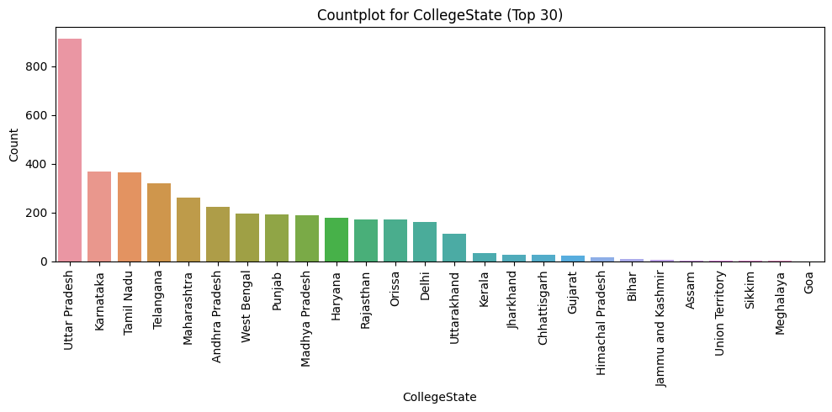
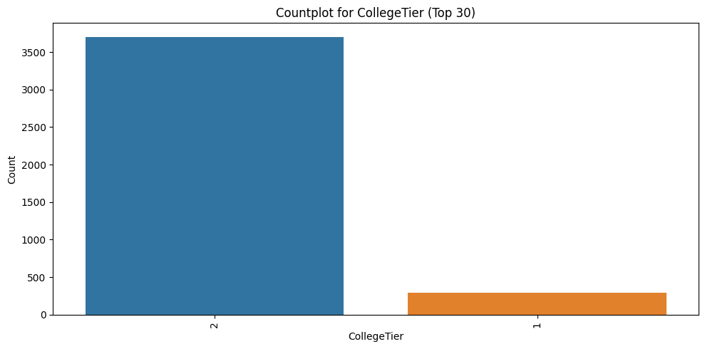
Univariate Categorical Analysis :
Most candidates completed their college in Uttar Pradesh, then followed by Karnataka and Tamil Nadu.
Most candidates completed their college in 2nd Ties Colleges.

Slide 7
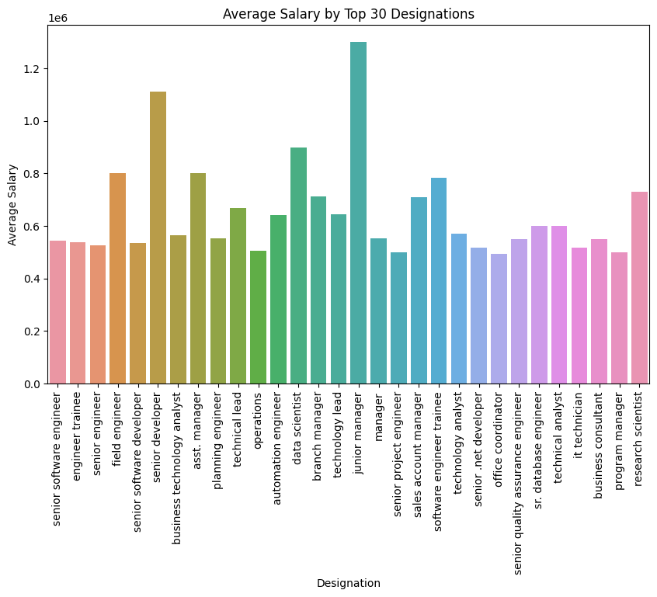
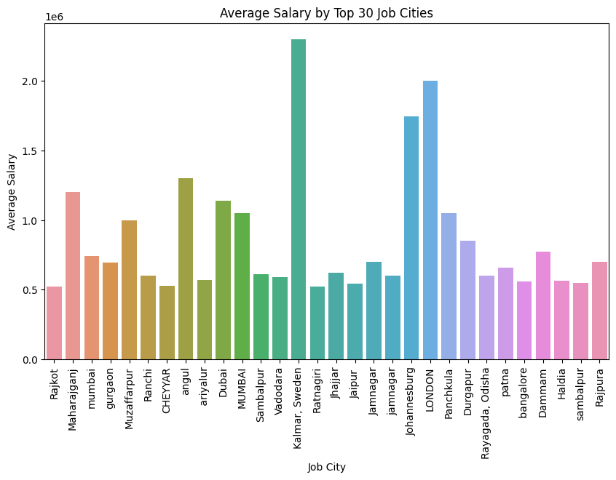
Bi-Variate Numerical vs Categorical Analysis :
Top 3 designation which make more average salary are Junior Manager, Senior Developer and Data Scientist.
Top 3 Job City which make more average salary are Sweden, London and Johannesburg.

Slide 8
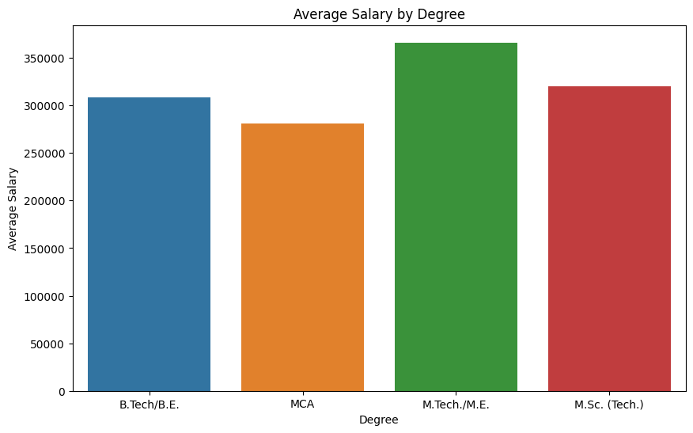
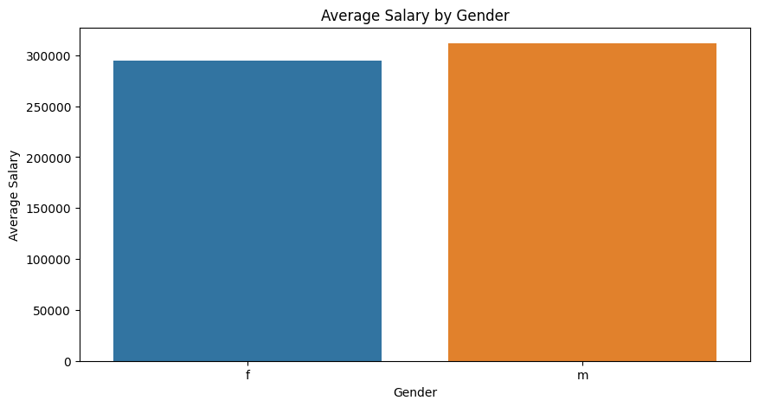
Bi-Variate Numerical vs Categorical Analysis :
Degree with M.Tech./M.E. make more average salary.
Average salary of male and female are almost same.

Slide 9
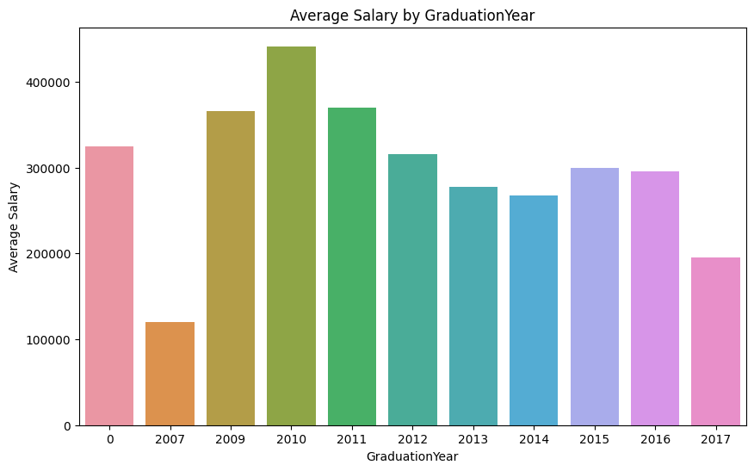
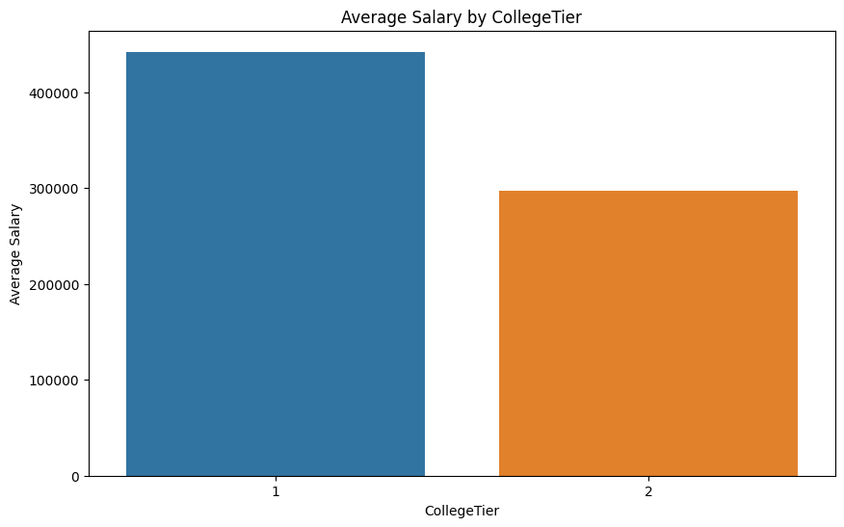
Bi-Variate Numerical vs Categorical Analysis :
Top 3 Graduation Year which make more average salary are 2010, 2009 and 2011.
Average Salary of 1st Tier College is more than the 2nd Tier College.

Slide 10
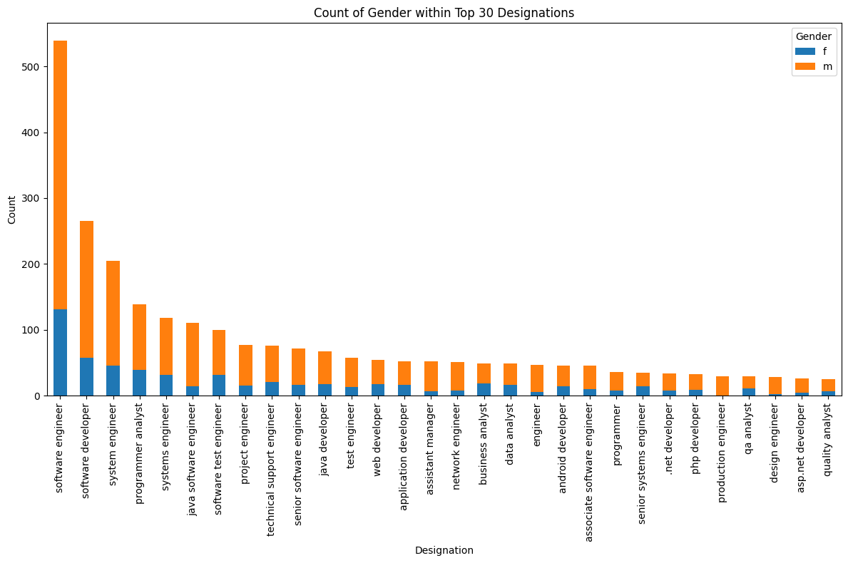
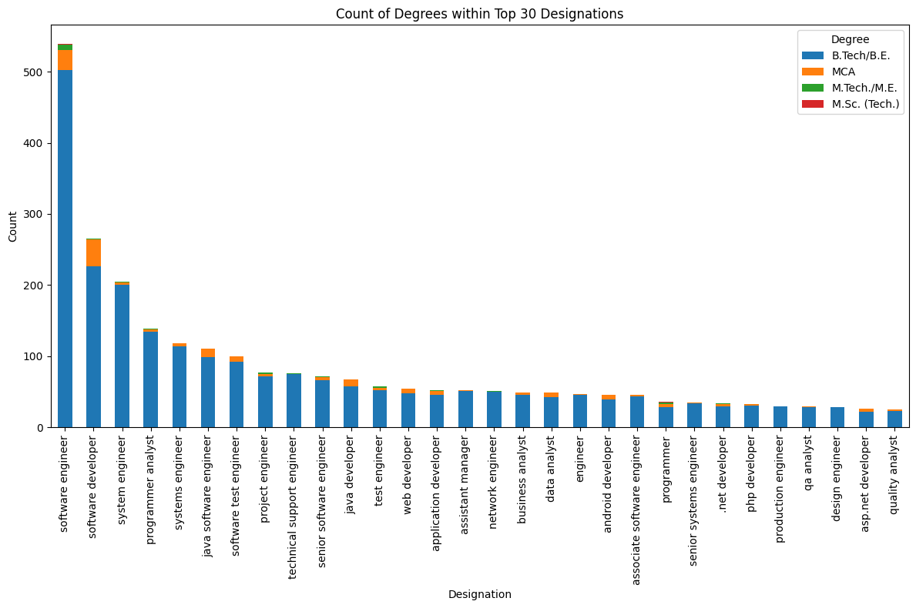
Bi-Variate Categorical vs Categorical Analysis :
In top 30 Designation, there are more male candidates compared to female candidates in each designation.
In top 30 Designation, B.Tech/B.E. candidates are more than any other degree candidates.

Slide 11
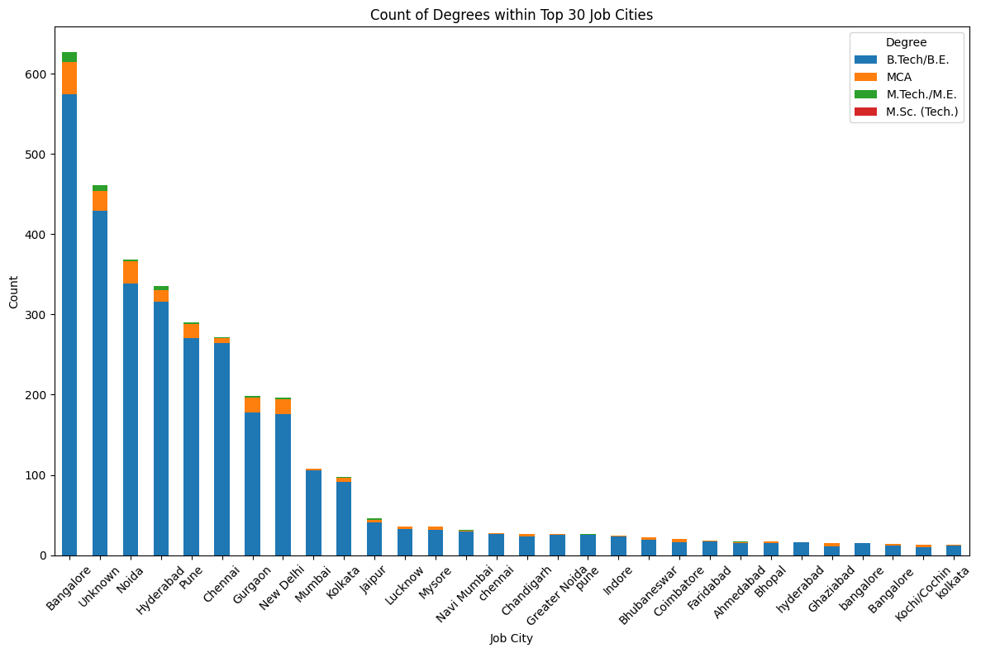
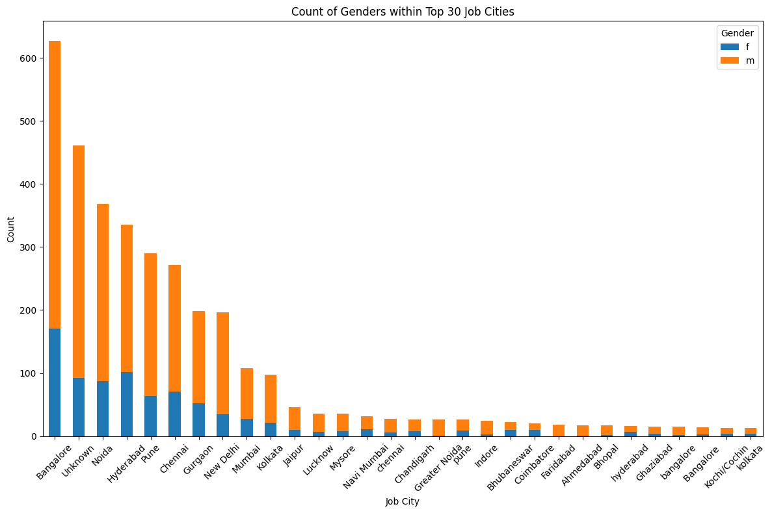
Bi-Variate Categorical vs Categorical Analysis :
In top 30 Job City, B.Tech/B.E. degree candidates are more than any other degree candidates.
In top 30 Job City, male candidates are more than female candidates.

Slide 12
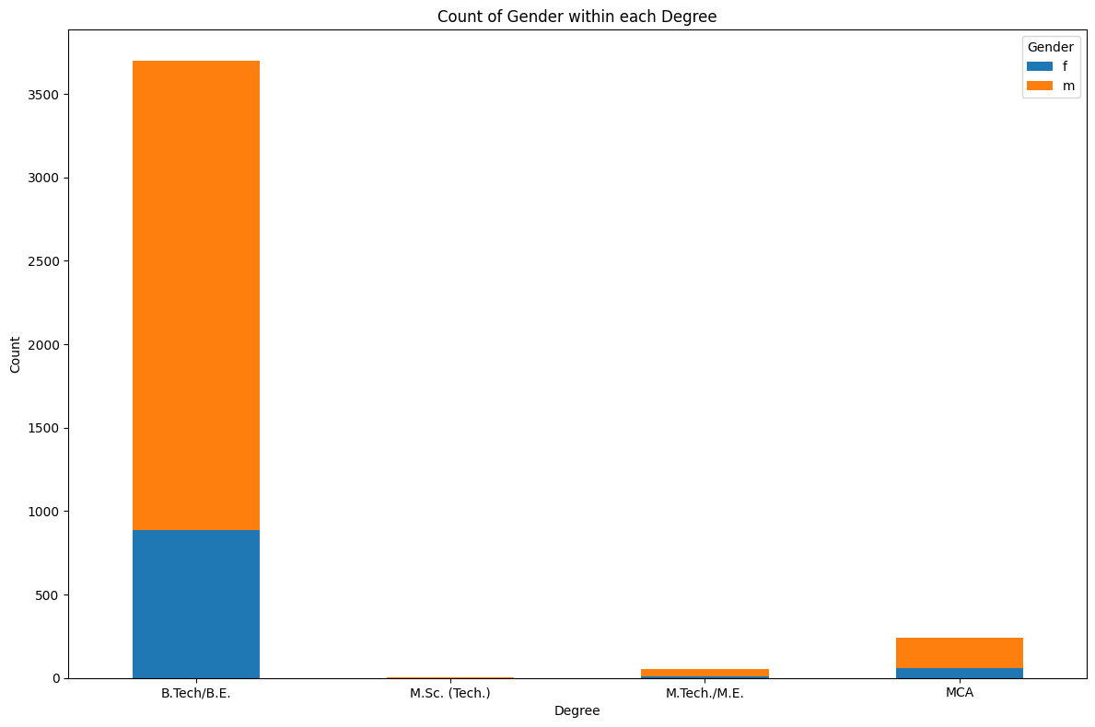
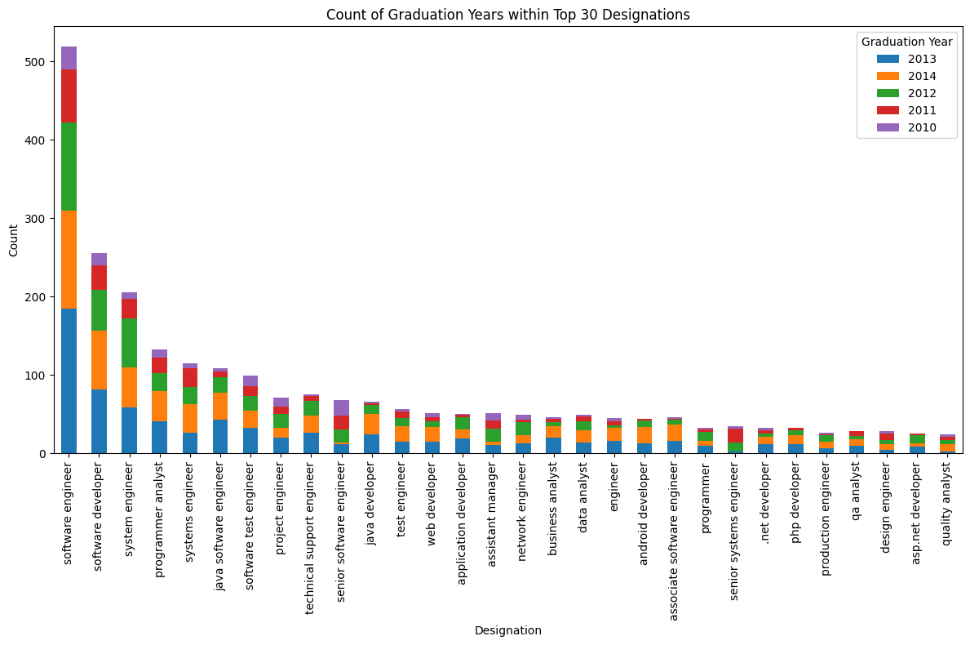
Bi-Variate Categorical vs Categorical Analysis :
There are more male candidates in all degree programs then female candidates.
In top 30 Designation, 2013 and 2014 who graduated from college are more than other graduated years.

Slide 13
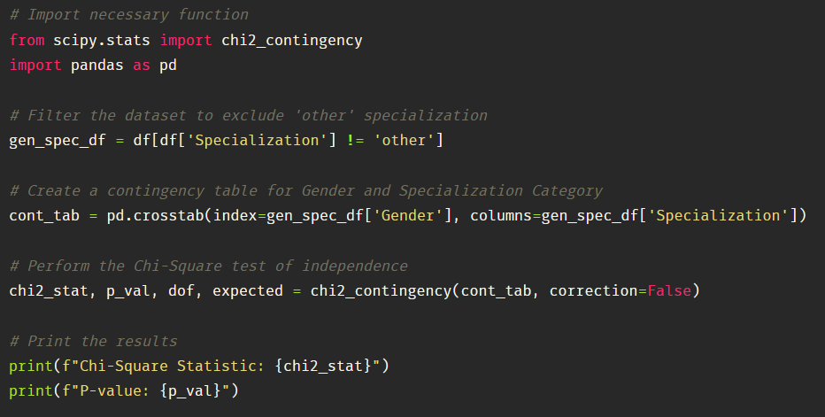

Is there a relationship between gender and specialization? (i.e., Does the preference of Specialization depend on the Gender?)
The p-value associated with the statistic (p = 2.912e-10) is much smaller than the chosen significance level, suggesting that the variable Gender and Specialization are independent of each other.
Therefore, there is no significant association between Gender and Specialization.

Slide 14

THANK YOU

